Slide 1

Digital Inclusion in India: Census
Presented By
Biswajeet .D
Notes:
Specific only to the project on Examining the Digital Inclusion

Slide 2
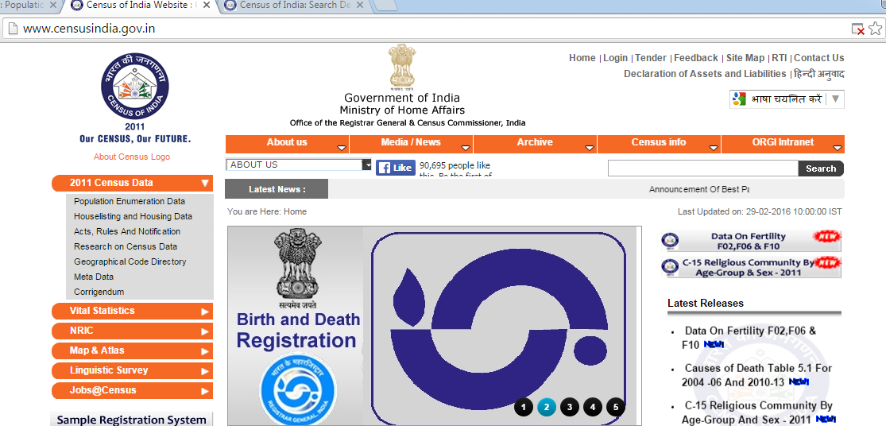
Introduction
Census is a process to collect ,analyze, evaluate and publish the statistical data about the population .
It includes the till date information about different household assets ,demographic, social and economic data .

Slide 3
Background..
Census 2011 was collected for the first time for household level data on Computer, Internet and Mobile
Digital India Program
No known study …beyond anecdotal / journalistic articles using descriptive statistics

Slide 4
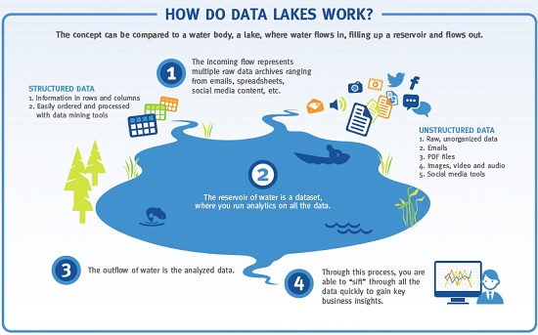
Census : Data Lake
A data lake is a massive, easily accessible, centralized repository of large volumes of structured and unstructured data.

Slide 5
Objective
To demonstrate the use of analytical tools for drawing insights from publicly available dataset(Census Data) that can be used for :
Social/Public policy evaluation
Formulation.

Slide 6
Project Scope
To perform a comparative study using analytical techniques and predict the nature and extent of digital inclusion in India upto village level and to identify common factors (both infrastructural and social economic indicators) at village levels of a state that affects the inclusion based on 2011 census data.

Slide 7
Need of Census…
It provides valuable information for planning and formulation policies for Central and the State Governments
Used by National and International Agencies, Scholars, business people, industrialists, and Statisticians.

Slide 8
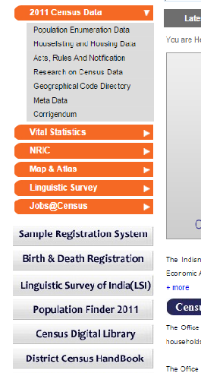
The location of the specific datasets
Population Enumeration Data
House listing and Housing Data

Slide 9
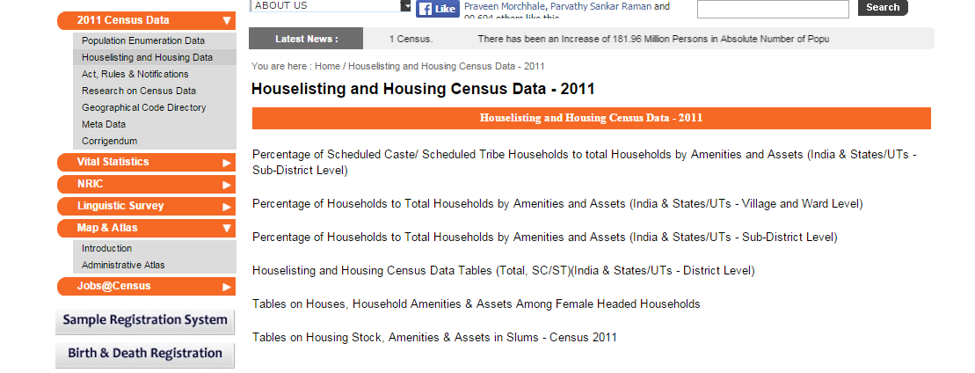
(1) Houselisting and Household Census Data
Data (actual numbers )only up to district level
Notes:
http://www.censusindia.gov.in/2011census/hlo/HLO_Tables.html

Slide 10
Functionalities
What are the common characteristics of villages having similar (high/ medium/low) levels of digital inclusion?
Take penetration of computers as the sum of computers with internet and computers without internet
Do villages that are better off in terms of infrastructure facilities and socio-economic indicators have higher levels of digital inclusion?
Since the number of villages are large , selected visualizations with general trend and outliers

Slide 11
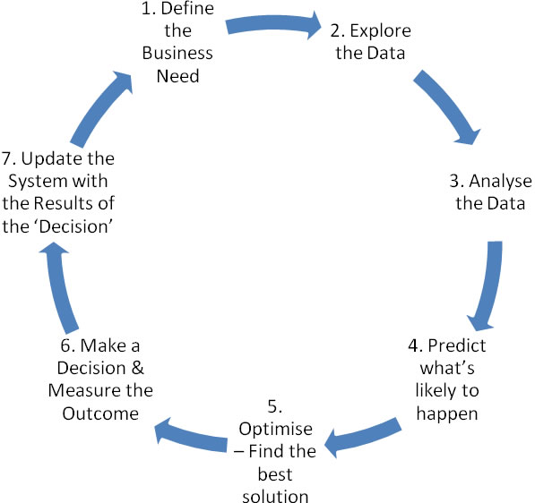
Analytics Life Cycle

Slide 12
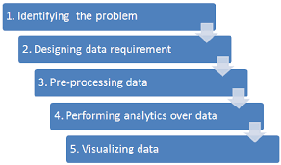
Steps Performed ….
Formatting
Cleaning
Sampling

Slide 13
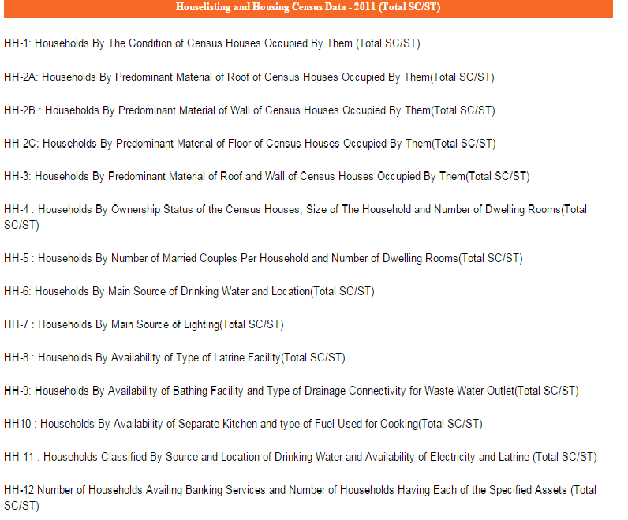
(1a) Houselisting and Household Census Data (District Level)

Slide 14
Houselisting and Household Census Data
The alternative is to use the data given in percentage separately for district / sub-district and village/ward level. The advantage is that it has almost all the columns of the previous 14 tables and can be used for the advance analytics part
Notes:
http://www.censusindia.gov.in/2011census/hlo/HLO_Tables.html

Slide 15
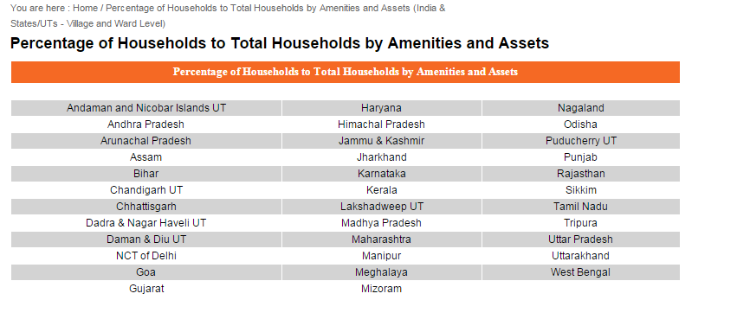
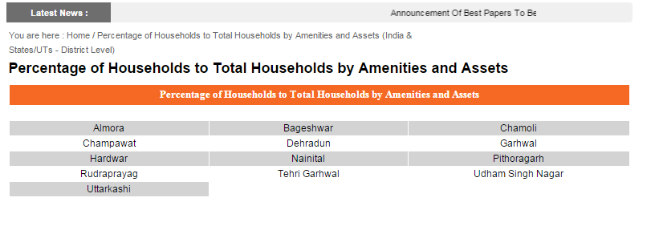
(c) Houselisting and Household Census Data (percentage at village level)
Data is organized state-wise
Within each state, village or ward data is available district-wise and the individual excel sheets need to be merged for further analysis

Slide 16
Performing Analytics
From the Master Dataset out of 90 features Select the best features using Principal Component Analysis.

Slide 17
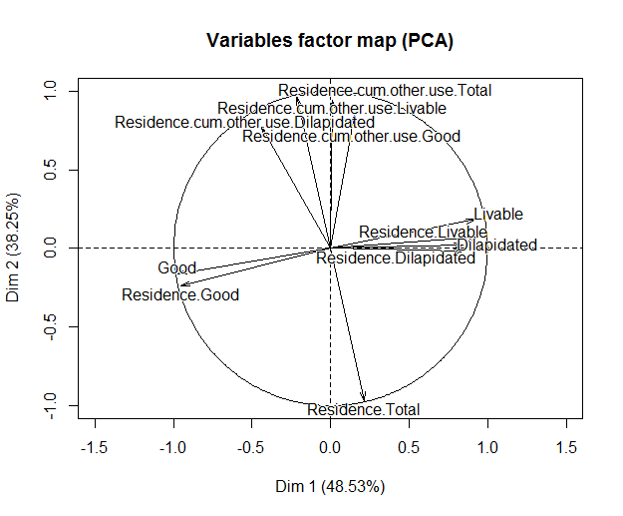
PCA - Features

Slide 18
Train & Test Datasets
Train Set – 1084 observations , 7 features
Test Set - 770 observations, 8 features

Slide 19
Findings
Features selected - Dimensionality reduction Technique using Principal Component Analysis(PCA) .
Trends and Patterns observed on the census data - Tableau Desktop.

Slide 20
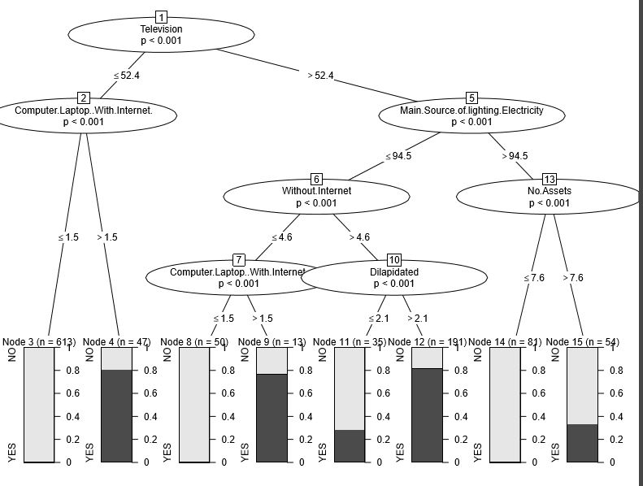
Decision Tree

Slide 21
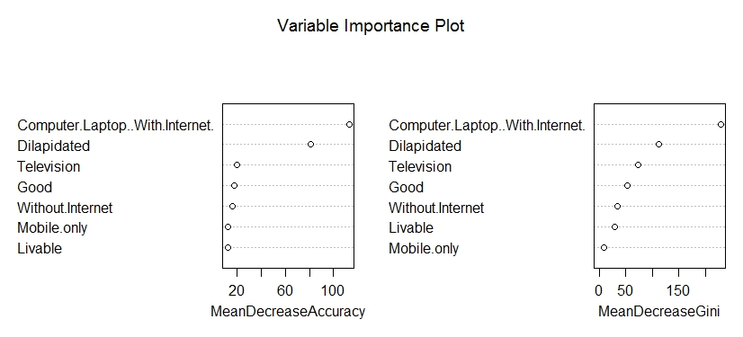
Variable Importance Plot

Slide 22
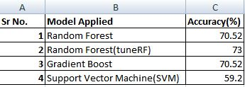
Best Model Analysis

Slide 23
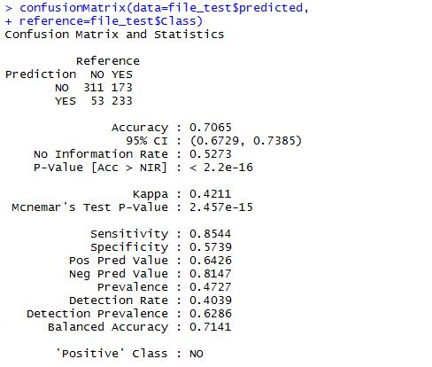
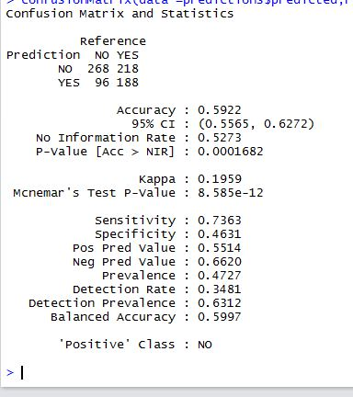
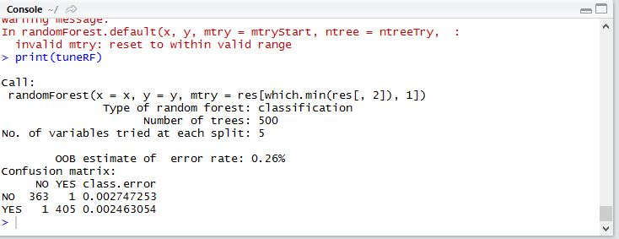
Accuracy % in R

Slide 24
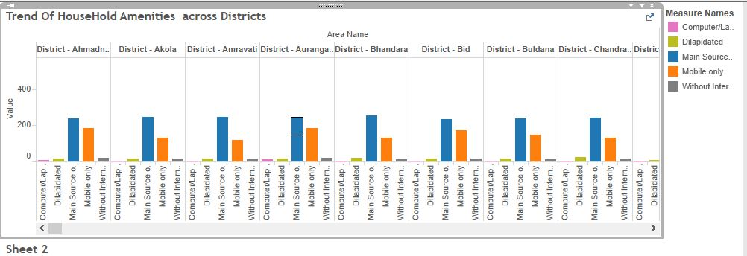
Trend – Household Amenities

Slide 25
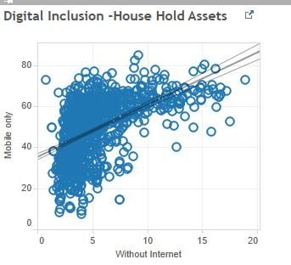
Pattern - HouseHold Assets

